Slide 1


Slide 2
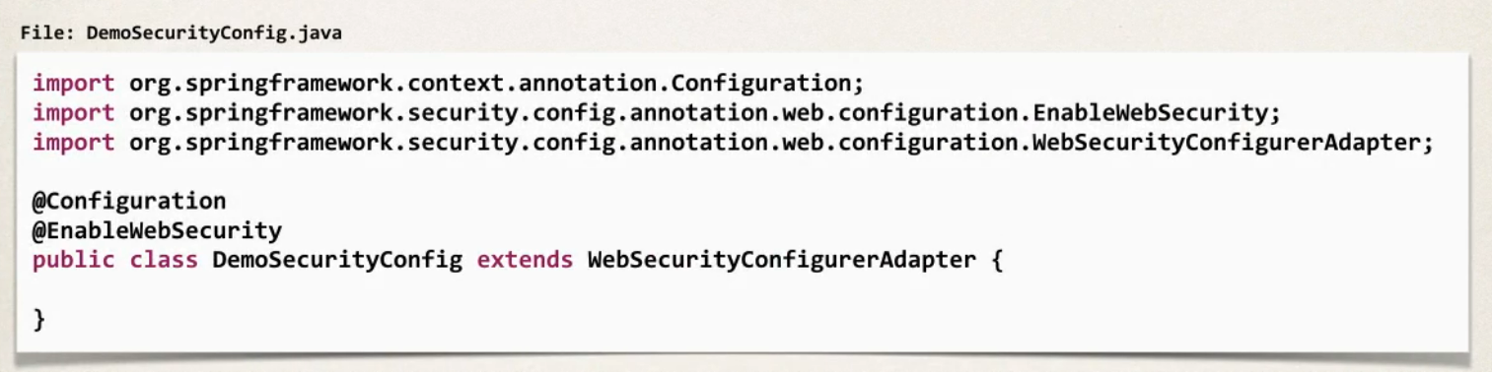
Step-1 Spring Security Configuration

Slide 3
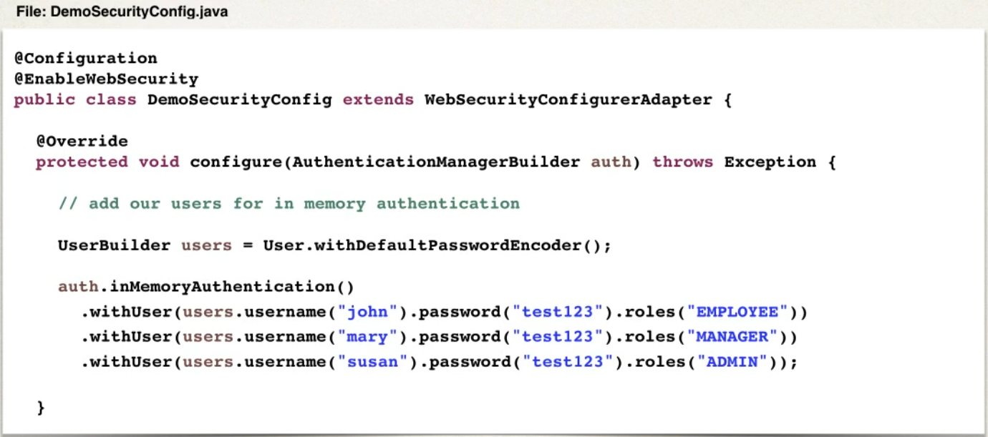
Step-2 Add users, password and roles

Slide 4
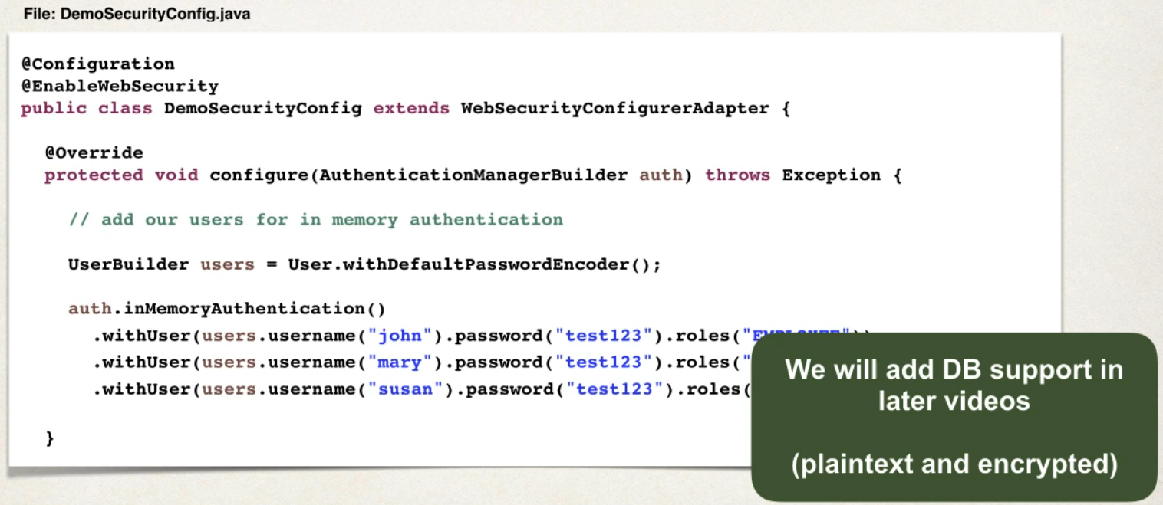
Step-2 Add users, password and roles

Slide 5
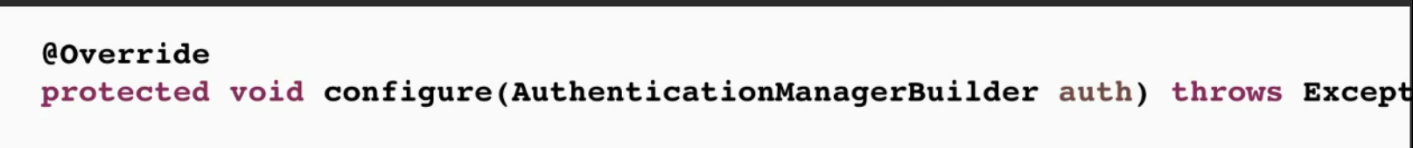
Step-2 Add users, password and roles

Slide 6
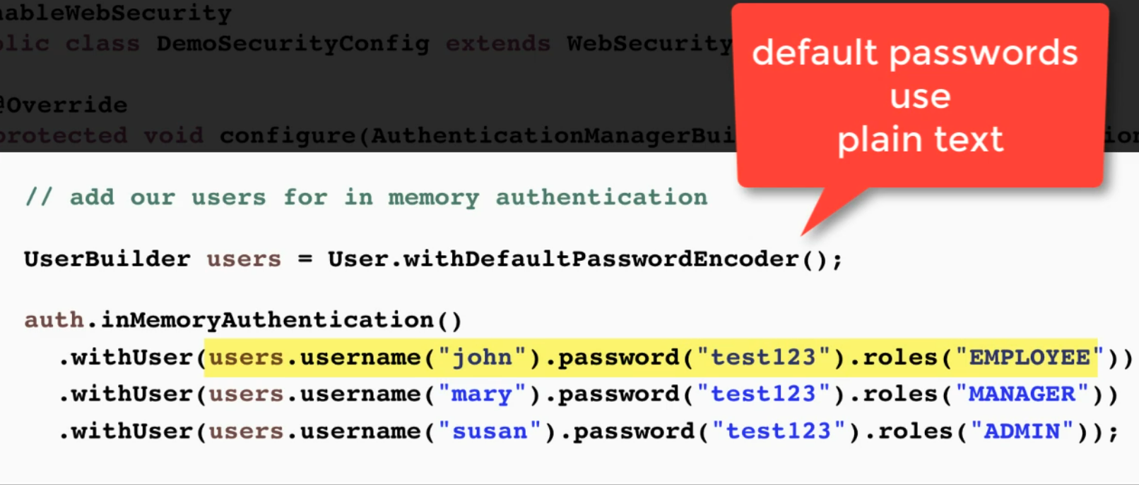
Step-2 Add users, password and roles

Slide 7
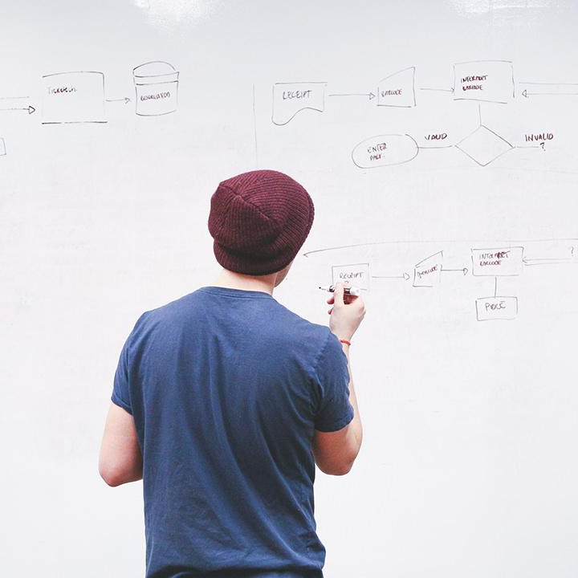
HELLO!
I am Vishal Thakur
I am here because I love to give presentations.
You can find me at @username

Slide 8
THANKS!
Any questions?
You can find me at
@username & user@mail.me

